Slide 1
Write a program to convert following code into assembly program.
IF AX < 0
THEN
PUT -1 IN BX
END IF

Slide 2
Lab Tasks
Task: 2
Write a program to convert following code into assembly progam.
IF "AL < 0
THEN
put FFh in AH'
ELSE
put 0 in AH
END_IF

Slide 3
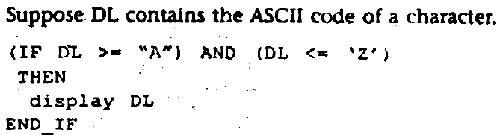
Lab Tasks
Task: 3
Write a program to convert following code into assembly program.

Slide 4
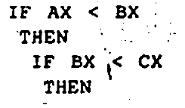
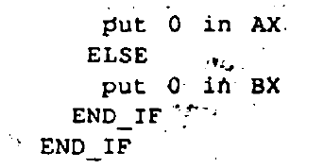
Lab Tasks
Task: 4
Write a program to convert following code into assembly program.

Slide 5
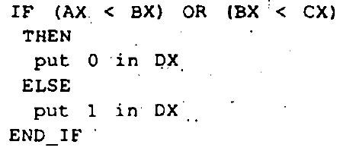
Lab Tasks
Task: 5
Write a program to convert following code into assembly program.

Slide 6
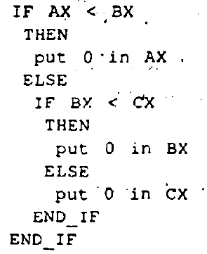
Lab Tasks
Task: 6
Write a program to convert following code into assembly program.

Slide 7
Lab Tasks
Task: 7
Write a program to display "o" if AL contains 1 or 3; if AL contains 2 or 4, display "e"..

